Slide 1
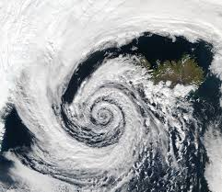
Cyclones

Slide 2
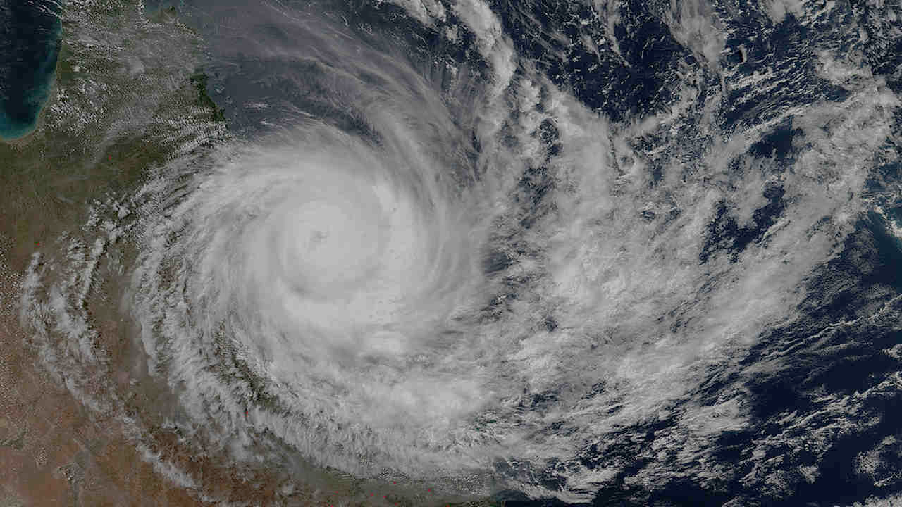
What is a Cyclone ?
A cyclone is a violent storm, usually accompanied by strong spiraling winds, heavy rains and tidal waves.
It develops over the sea and then may move over land, causing great damage.
A cyclone may be hundreds of kilometers wide with winds blowing at 120 km/ h or more.
Cyclones are generally restricted to tropical latitudes.

Slide 3
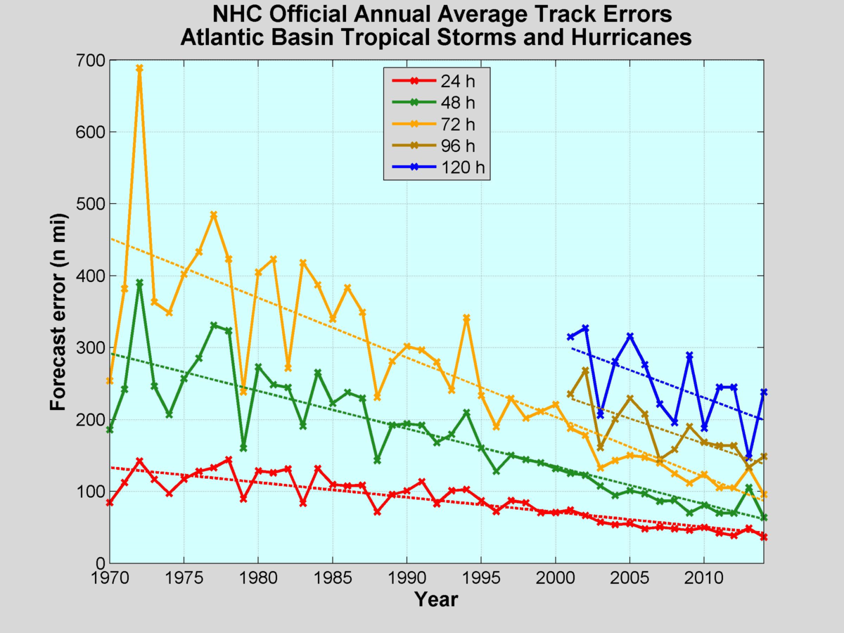
forecast OF CYCONEs

Slide 4
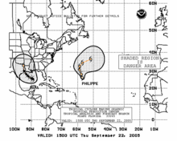
How is it DONE ?
Cyclone forecasting is the science of forecasting where a cyclone’s centre, and its effects, are expected to be at some point in the future.
There are several elements to tropical cyclone forecasting: track forecasting, intensity forecasting, rainfall forecasting, storm surge, tornado, and seasonal forecasting.
Over the years forecast methods have moved from simple subjective deductions based on observations of specific parameters such as cloud types and motions, sea swells, and pressure, to more sophisticated techniques which use complex computer models of the atmosphere.
Until recently predictions were centred around the motion of the cyclone, but both motion and intensity are now being routinely predicted.

Slide 5

Planning FOR cyclones

Slide 6

How government does planning?
Government forecasts cyclones 24 hours in advance with the help of satellites and radars.
Cyclone and Tornado shelters are made for people living in cyclone prone areas. These are rooms made underground and away from shores having no windows.
Quick communication to government agencies, fishermen, ports to make necessary arrangements and minimize destruction.

Slide 7
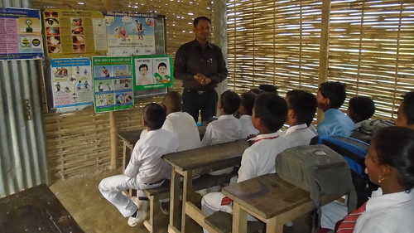
Creating awareness among people

Slide 8
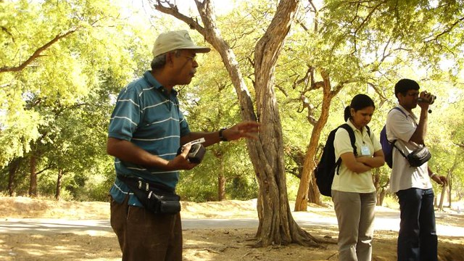
How can it BE DONE ?
Partner with local community emergency response teams (CERTs)
Hold a build-an-emergency-kit party. Invite citizens who do not have an emergency kit come to an informational meeting.
Host workshops on designing a financial first aid kit. Some people have a basic kit full of supplies, but they rarely have all their financial and insurance information written down in a place they can take with them if they need to evacuate.
Involve the local media in the planning process.

Slide 9
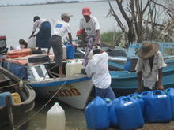
Medical care in cyclones

Slide 10
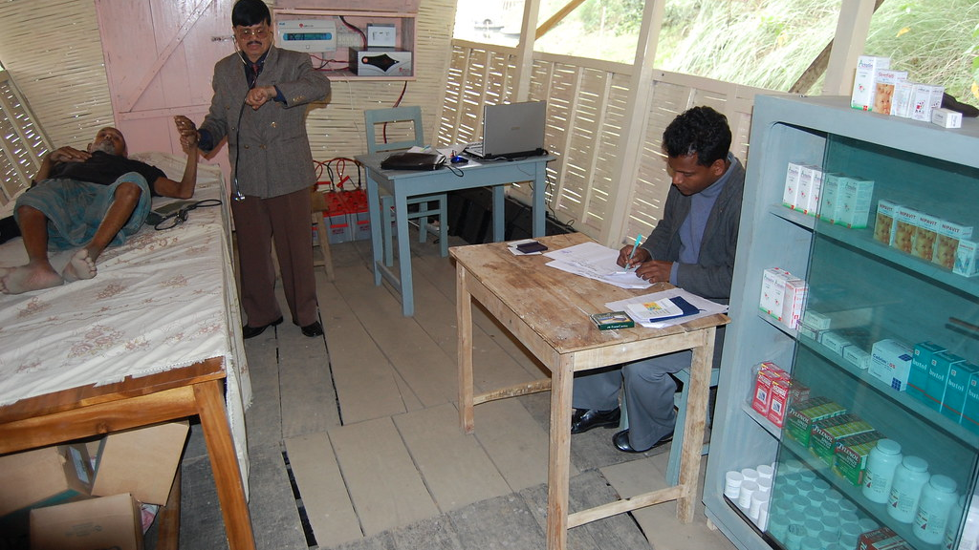
How is it done ?
Health care management in disasters is one of the main parts of disaster management.
In the health system, evaluating programs and making known their challenges is necessary in order to improve and implement the reforms.
The security of healthcare staff, the necessary facilities, and their required information are provided by different organizations
Health service organizations coordinate together according to defined organizational communications

Slide 11
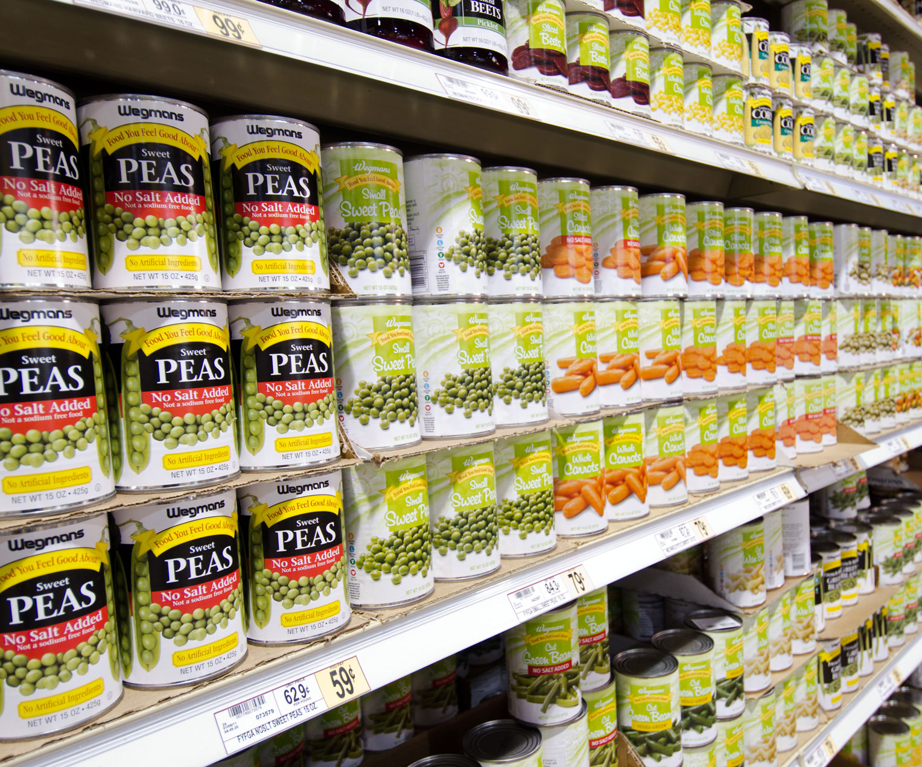
Food and water supply in cyclones

Slide 12
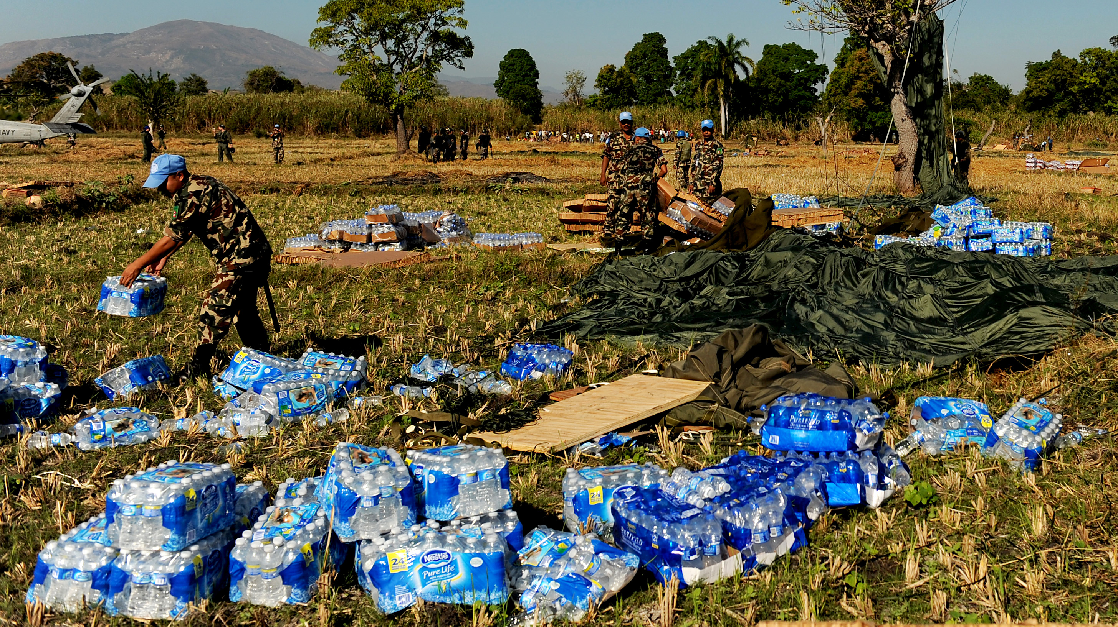
How is it given ?
Safe food and water supplies are a major concern following a cyclone. Knowing how to safely handle food and water in the immediate few days after the disaster can reduce stress, worry and inconvenience.
Government provides public health and other authorities with guidance on key food safety issues to be considered in such disaster situations
Government also provide guidance for the development of simple food safety messages to those involved in food handling and preparation in disaster areas, including ordinary consumers.
Water for drinking and food preparation should be treated as contaminated unless specifically confirmed as safe.

Slide 13
Communication and electricity in cyclones

Slide 14
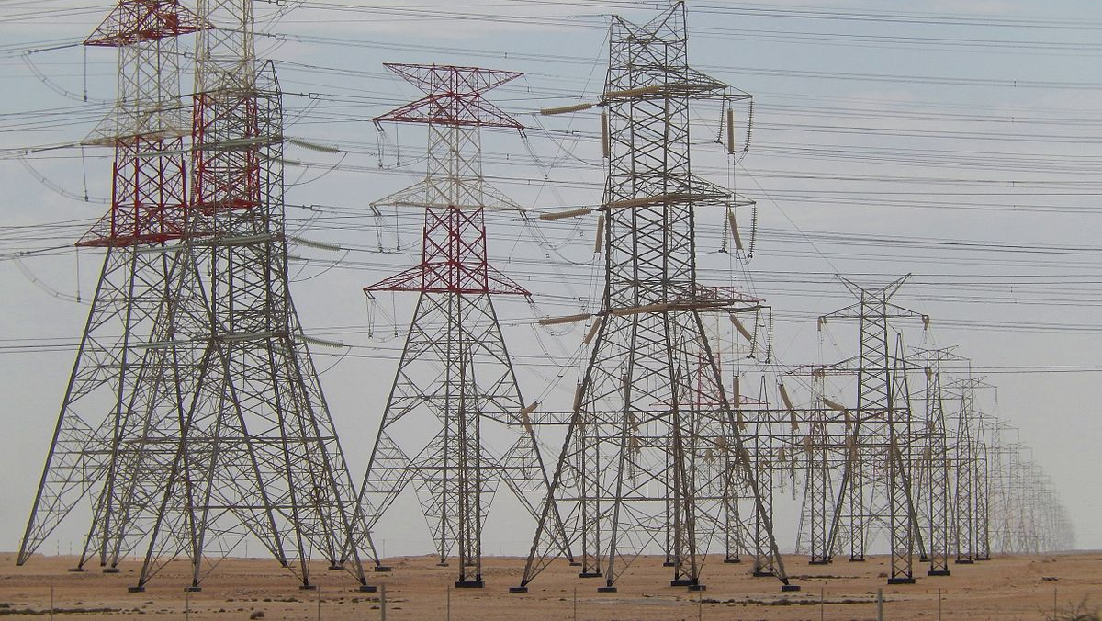
How is it done ?
Communications are the pillar of any emergency response and recovery effort. They allow crews to coordinate tasks, keep one another informed of developing information, and maintain safety within their own organizations.
It’s vital that emergency crews are confident that they have a reliable, resilient communications system to allow them to safely and effectively continue their efforts.
There have been many innovations in the world of mission critical communications, but land mobile radio (LMR) continues to hold its own as the reliable backbone for critical communications, thanks to several key features.

Slide 15
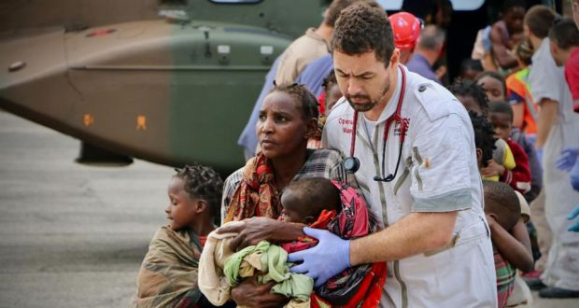
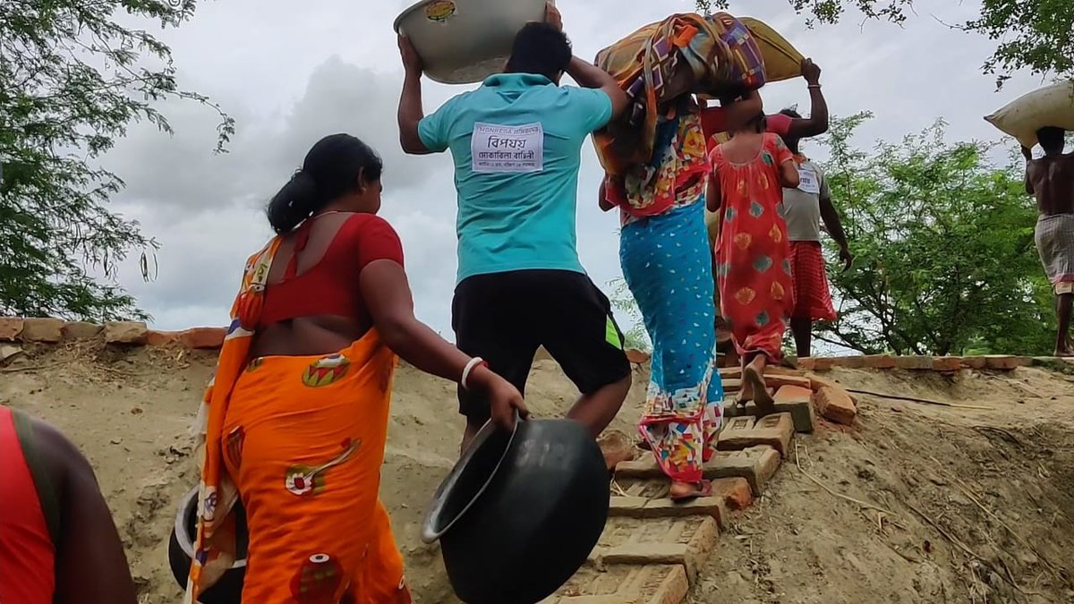
Safety of people in cyclones

Slide 16
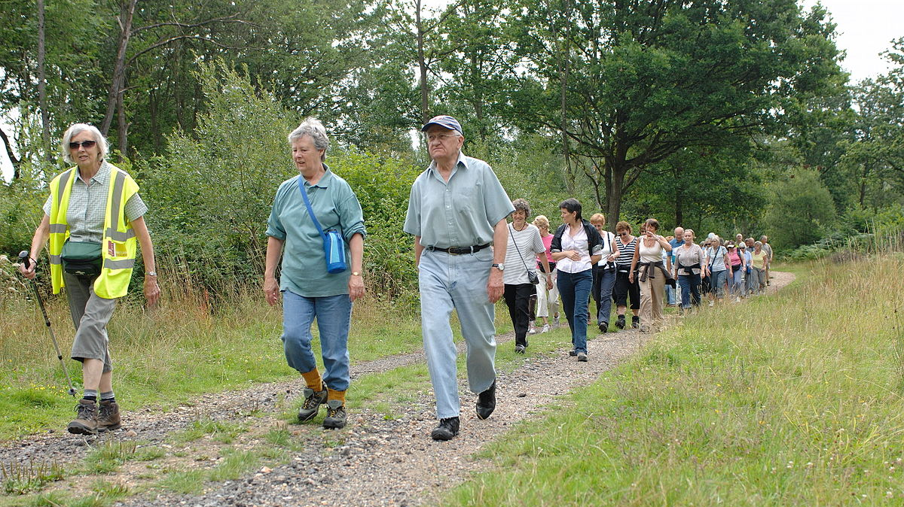
How can we take care of ourselves ?
If you have not been ordered to evacuate, stay in a safe area or shelter during a cyclone. In your home, a safe area may be a ground floor interior room, closet or bathroom. Be sure you have access to your survival kit in case you are in an emergency event that lasts several days.
Listen to your portable radio for important updates and instructions from local authorities. Remember to have a battery-powered radio in your survival kit. Some radios are now equipped with multiple power sources, such as batteries, solar panels and a hand crank.
If power is lost, use a generator with caution. Make sure conditions are safe before operating a portable generator. Only operate it outside — away from windows, doors or vents. Follow all manufacturer’s instructions.
Stay in your safe area and do not drive until the danger has passed.
Resist the temptation to check on your property until you are sure it is safe to do so.

Slide 17


